Slide 1
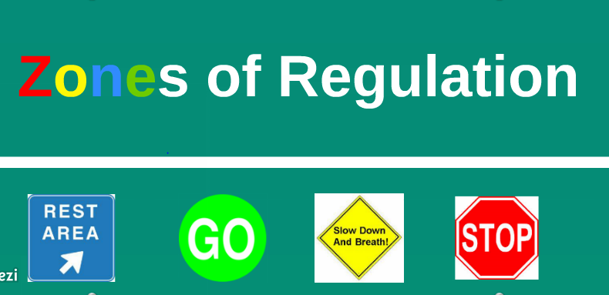

Slide 2
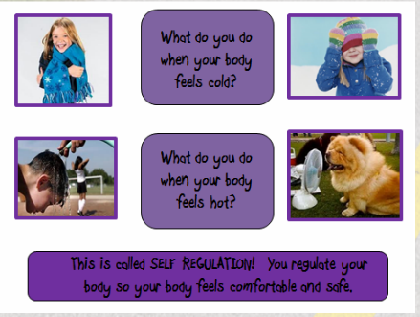
What is self regulation?
The ability to focus your attention, control your emotions and manage your thinking, behaviour and feelings.

Slide 5
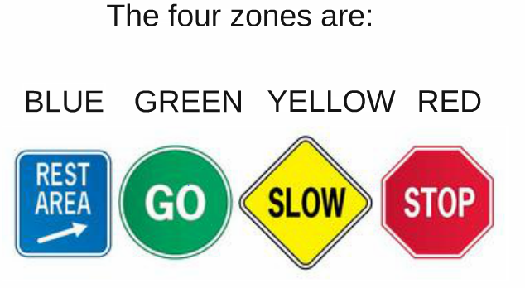
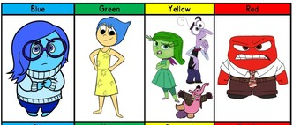

Slide 7
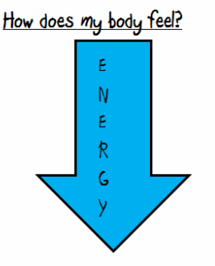
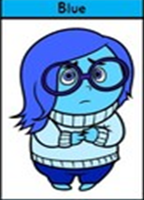
The Blue Zone
We are expected to be in the Blue Zone just before bed time or when we are watching the TV. We are running slow! We might be tired or sad. This is an unexpected zone to be in for learning.

Slide 9
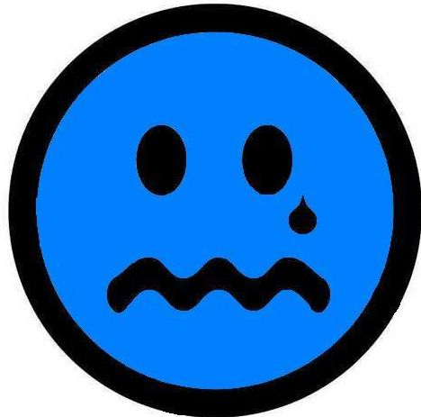
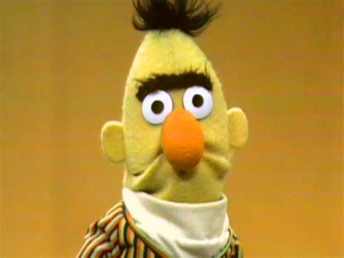
Bert feels sad
https://www.youtube.com/watch?v=ZgRN-AytScE

Slide 10
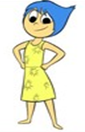
The green zone…..the learning zone!! We are expected to be in the Green Zone while we are learning. It is when our brains and bodies are relaxed and focused!

Slide 11
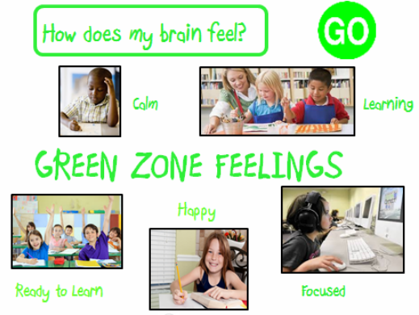

Slide 12
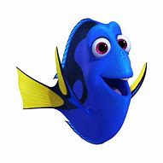
Dory in the green zone.
https://www.youtube.com/watch?v=sB6W2VAx2J8

Slide 13
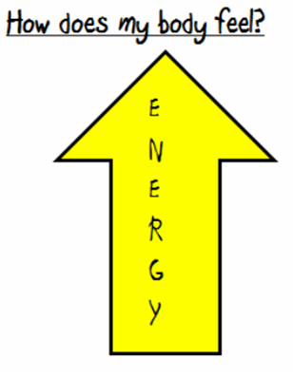
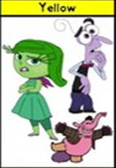
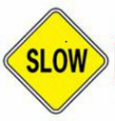
The Yellow Zone……during play time, lunch time and even at the end of the day, it’s expected for us to be in the YELLOW ZONE!!

Slide 15
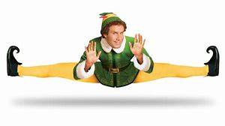
Elf in the yellow zone
https://www.youtube.com/watch?v=b6yYd6Pq7Ic&list=PLNtcYq0vdW0bE_Qc2fr-9zbngdax8rd7m

Slide 16
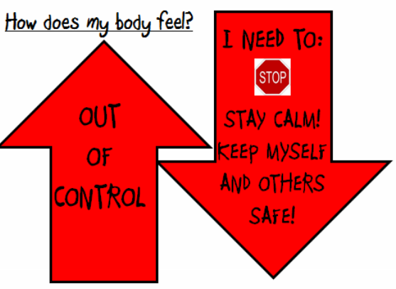
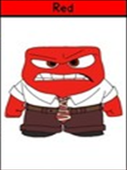
The Red Zone….when we are at school, the red zone is never expected! We must keep ourselves and others safe!

Slide 18
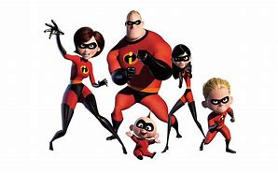
The Incredibles in the red zone!
https://www.youtube.com/watch?v=3v196bt5kTU&list=PLex1ABIduQCnlXSJgLC4u0fLFVbJIleWm

