Slide 1


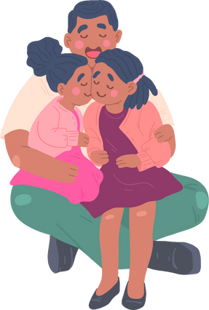
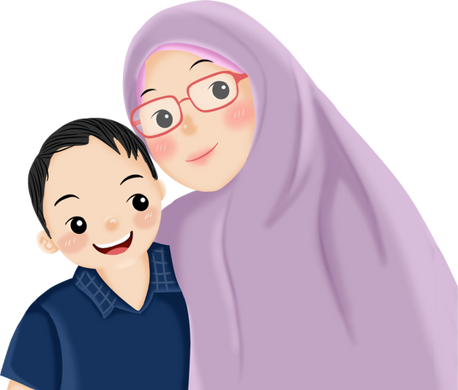
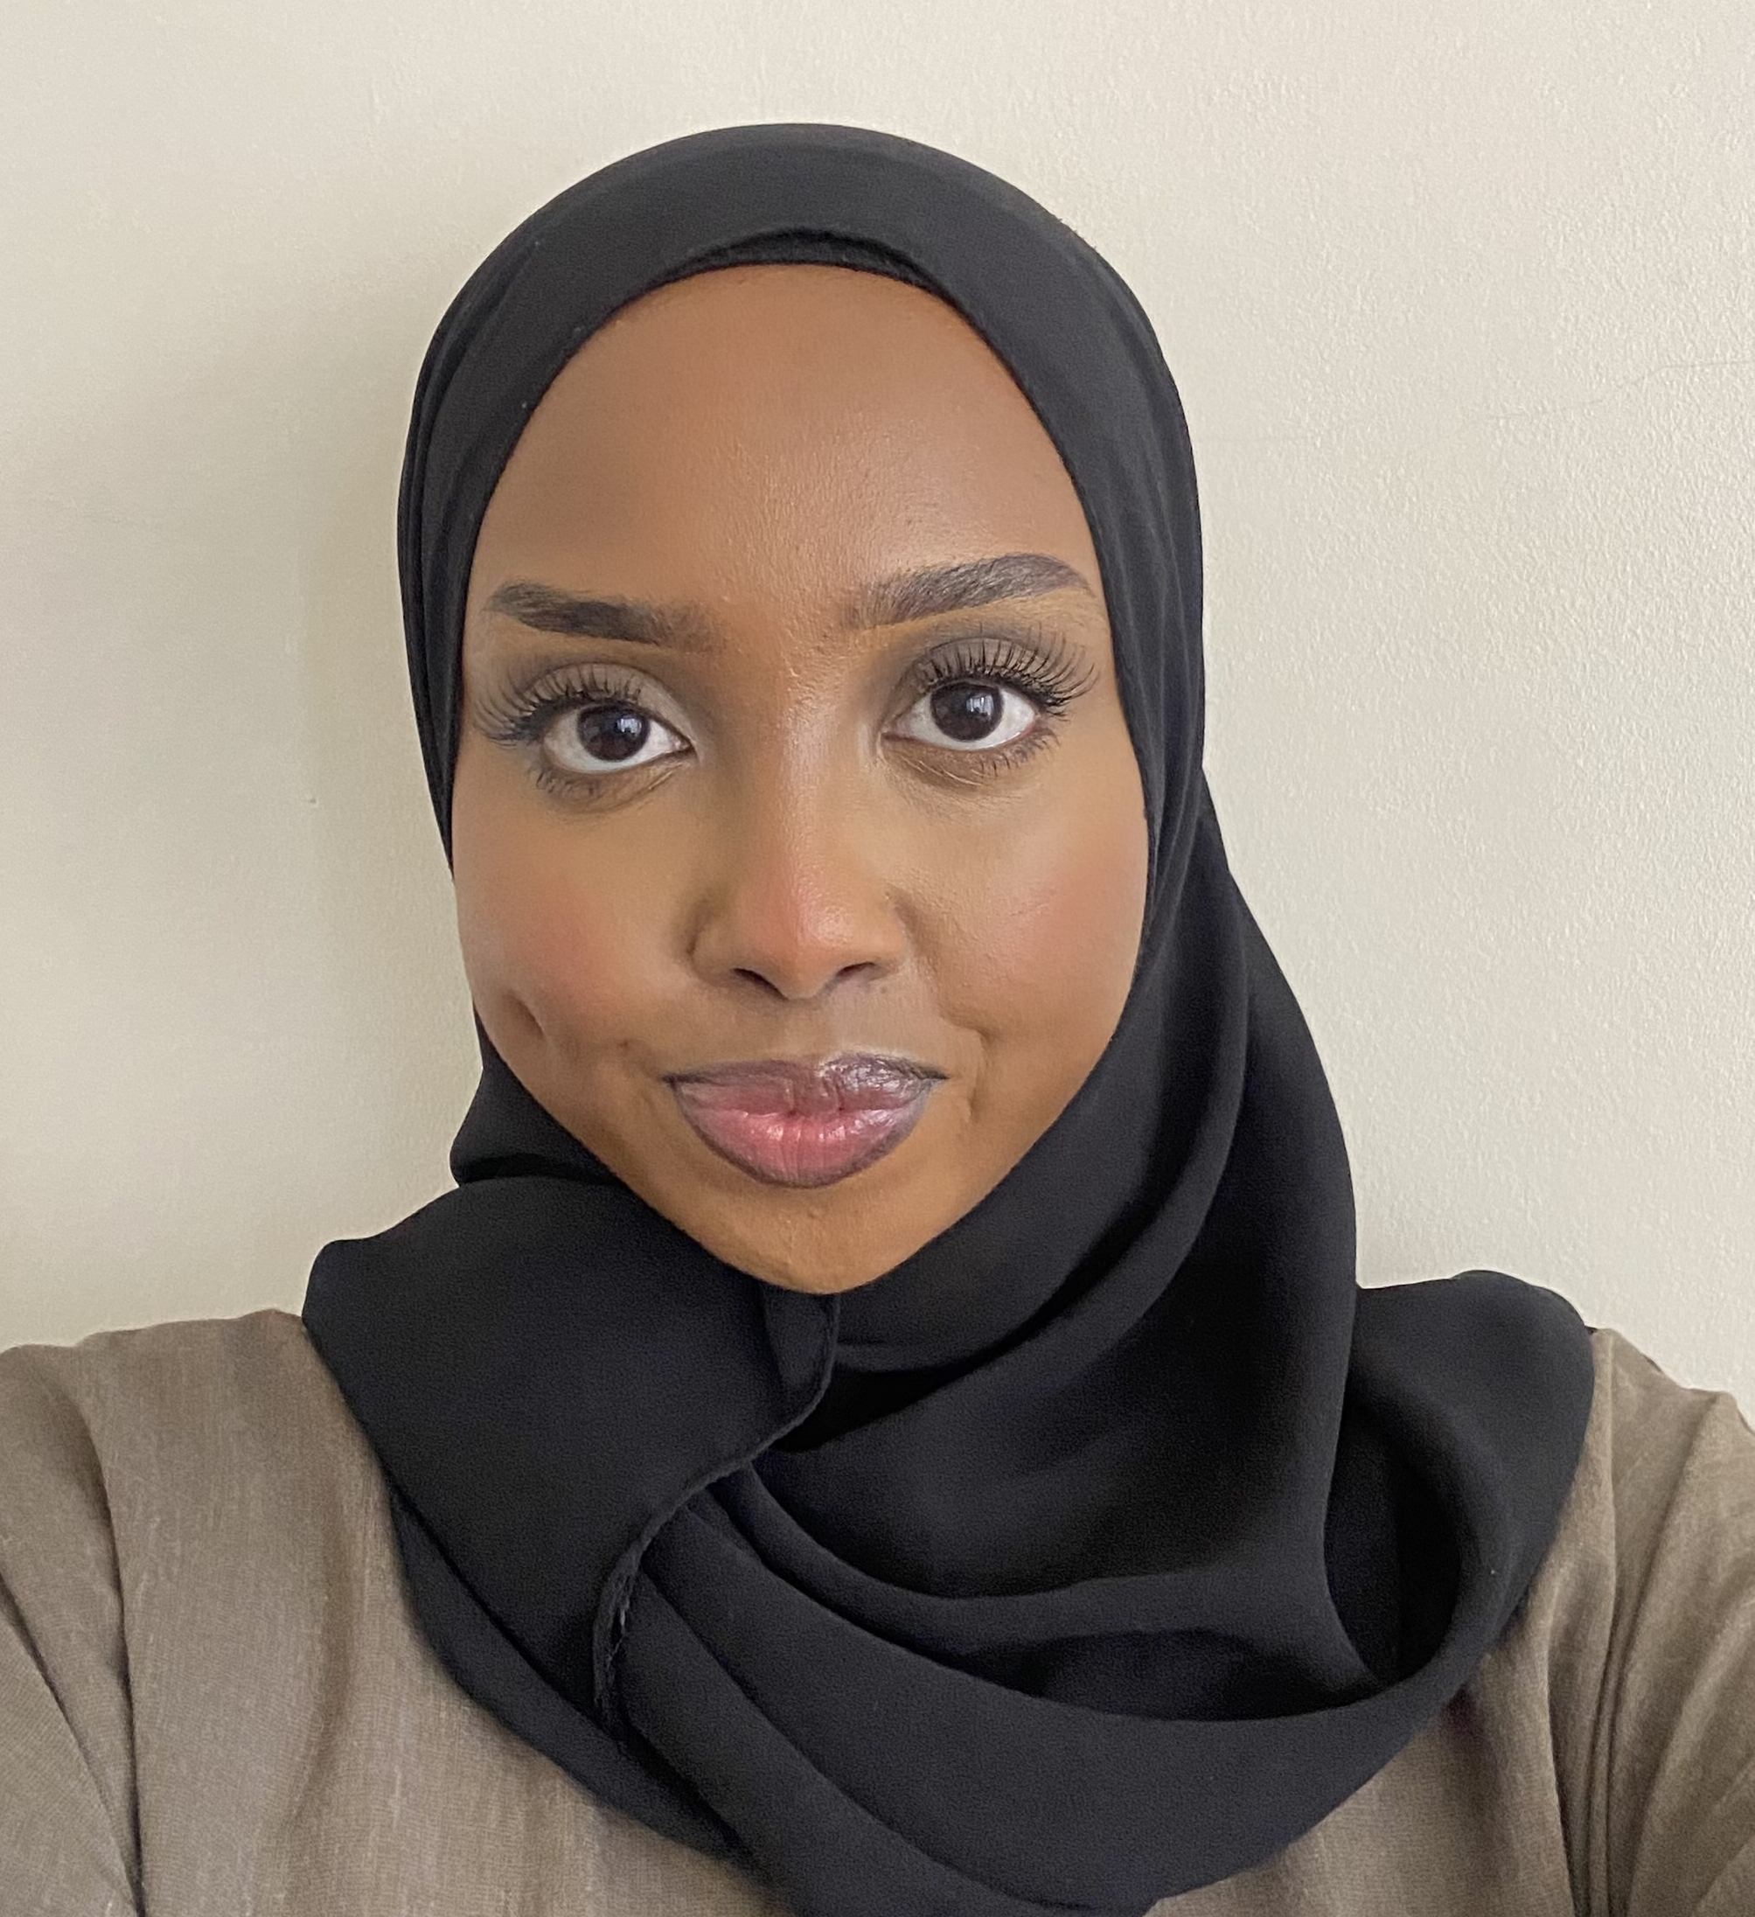
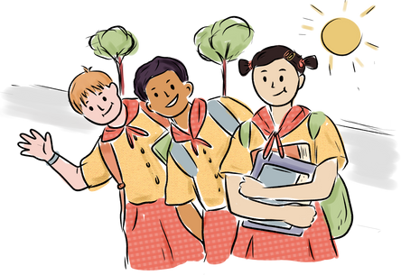
BRENT MENTAL HEALTH SUPPORT TEAM (MHST) LEAFLET
Newfield Primary School
Who are we?
The Brent Mental Health Support Team (MHST) is an early intervention service which works in partnership with primary and secondary schools in Brent to support children, their families and school staff build on their emotional understanding, wellbeing and resilience.
Meet your practitioner
Samsam
What do we do?
We deliver short-term, evidence-based interventions to support children experiencing mild-moderate mental health difficulties
We support schools with developing their whole school approach to mental health
We provide advice to school staff and liaise with other services to help children get the right help and stay in education

Slide 2

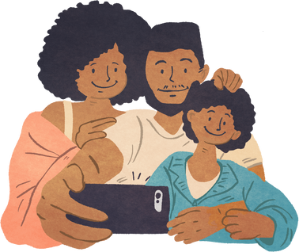
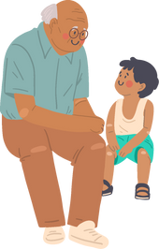

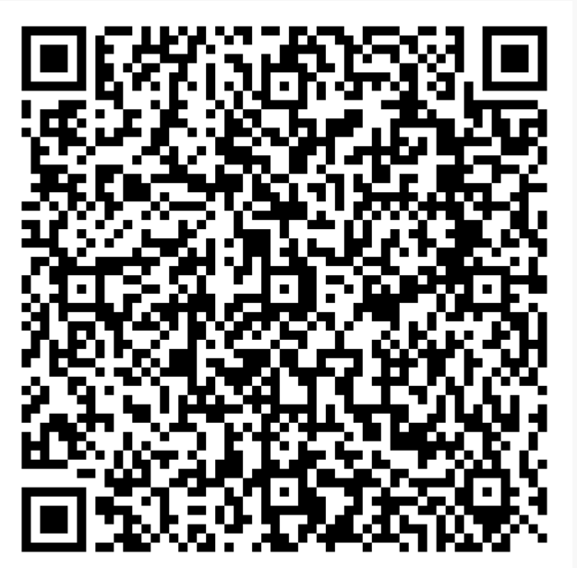
What support can we offer?
Parents/Carers
  1:1 Parent-led Guided Self Help on:
Managing Child Anxiety (5-11yrs)
(overcoming worries and fears, e.g. of going to school and sleeping alone. Using relaxation techniques, encouraging brave behaviour, etc.)
Managing Behaviour Challenges (5-8yrs)
(e.g. following instructions, setting routines, special time, encouraging desirable behaviours, etc.)
  Coffee mornings/afternoons, e.g. on understanding and managing anxiety
  Parent Workshops, e.g. on sleep routines, child-led play, online safety.
Parents/Carers Feedback
"X was easy to talk to and explained things well."
"The EMHP was professional, knowledgeable, they knew how to deal with behaviours, and gave good advice."
"Once the referral was made the communication was really quick. X showed empathy, and was supportive."
Young people feedback
"I understand my brain more than ever" - Yr 6
Children
  Brain Buddies - Year 4-6 whole class workshops on emotion regulation
  Workshops and Assemblies, e.g. on transitions, self-esteem
  1:1 or Group Specialist Work, e.g. with Cognitive Behavioural Therapy (CBT), Senior Wellbeing Practitioner (SWP), Play Therapy, Art Therapy and Dramatherapy
“I really looked forward to this each week because I knew I would be able to tell you anything and not get judged” - Yr 6
“The therapists really took everything I said seriously and they always plan very fun activities.” - Yr 4
If you think your child could benefit from accessing 1:1 support from MHST, please speak to us or the school Mental Health Lead
School Staff
  Case discussions and Consultations
  Signposting to resources and services
  Workshops, e.g. on staff wellbeing, spotting the signs of anxiety.
Scan here to visit our website

