Slide 1
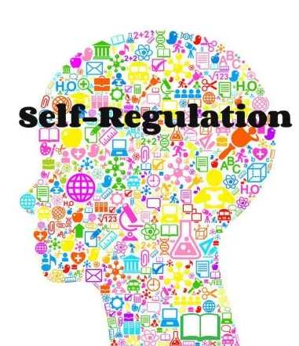

Slide 2
What is self regulation?
Self regulation is when you can:
focus your attention
control your emotions
manage your thinking
manage your behaviour
manage your feelings

Slide 3
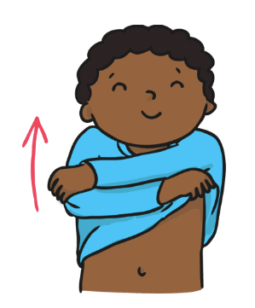
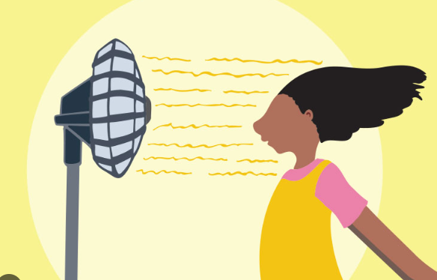
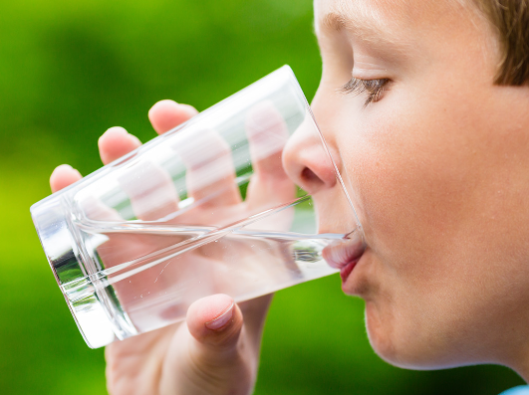
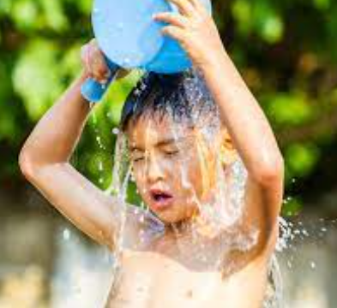
What might you do if your body feels hot?

Slide 4
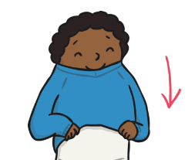
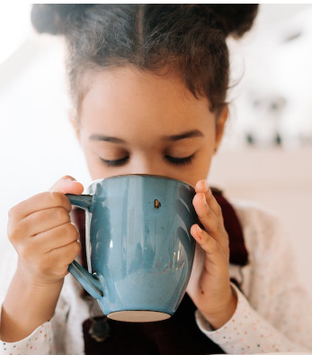
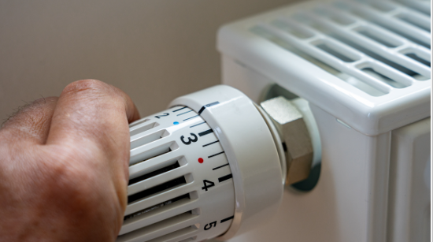

What might you do if your body feels cold?

Slide 5
This is called self regulation.
You regulate your body so that your body feels comfortable and safe.
But did you know that you can regulate your thinking and your feeling as well?

Slide 6

The first step to self regulation is identifying how your
body and brain feels.
There are four zones to help us with this.
These are called:

Slide 7
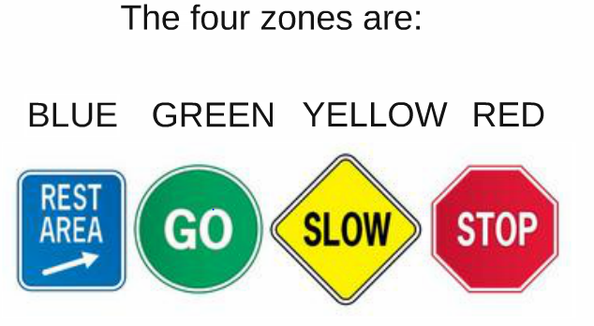

Slide 8
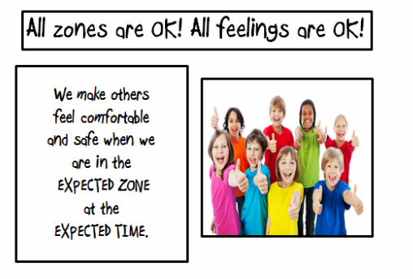

Slide 9

The Blue Zone
We are expected to be in the Blue Zone just before bed time or when we are watching the TV. We are running slow. We might be tired or sad. This is an unexpected zone to be in for learning.
How might your brain or body feel when you’re in the blue zone?

Slide 10
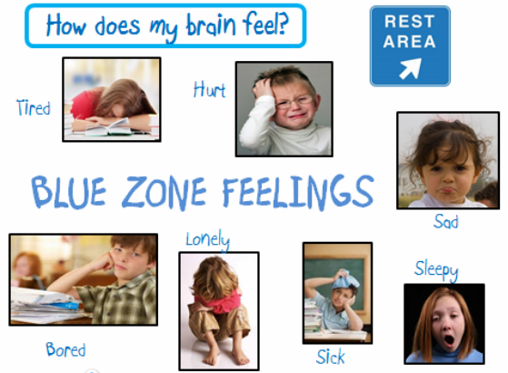

Slide 11

The Green Zone
We are expected to be in the Green Zone while we are learning. It is when our brains and bodies are relaxed and focused.
How might your brain or body feel when you’re in the green zone?

Slide 12
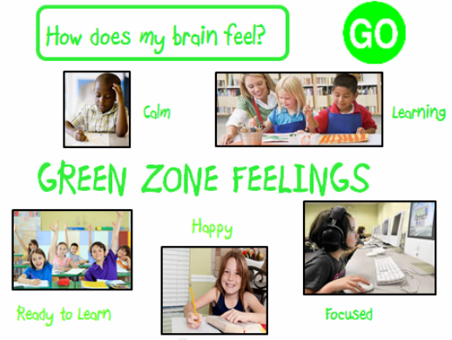

Slide 13
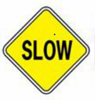
The Yellow Zone
During play time, lunch time and even at the end of the day, it’s expected for us to be in the YELLOW ZONE.
How might your brain or body feel when you’re in the yellow zone?

Slide 14
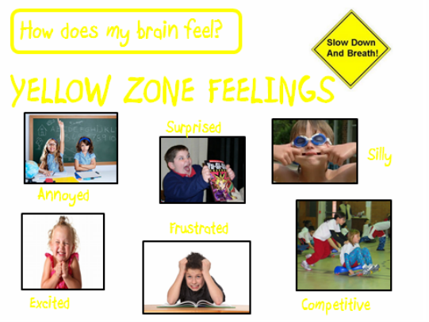

Slide 15
The Red Zone
You might be in the red one if you are elated, angry, terrified or feeling out of control.
For example if someone tells you a scary story or if you win a race at sports day.
How might your brain or body feel when you’re in the red zone?

Slide 16
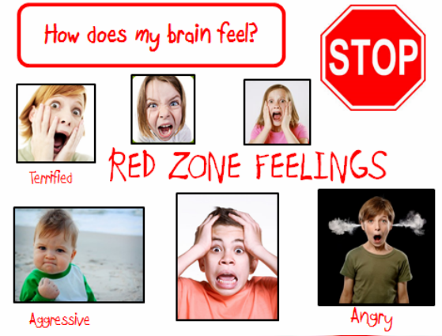

Slide 17
There is no bad zone.
Everyone experiences all of the zones at different times and in different circumstances.
You can also be in more than one zone at the same time.
It’s ok to be in the red zone. It’s ok to be in the blue zone. It is ok to be in the yellow zone. No one is expected to be in the green zone all of the time.
What is important is that you are able to self regulate and
- focus your attention
- control your emotions
- manage your thinking
- manage your behaviour
- manage your feelings

Slide 18


